Slide 1

The Norwegian Brain Council
Represent patient organizations, medical professional associations and scientific institutions
- Uniting for better Brain health.
26 patient organizations (with approx. 200 000 members)
40 professional associations and scientific institutions
(with approx. 5000 professionals)
Board represents the diversity
Research – Prevention – Treatment – Rehabilitation

Slide 2
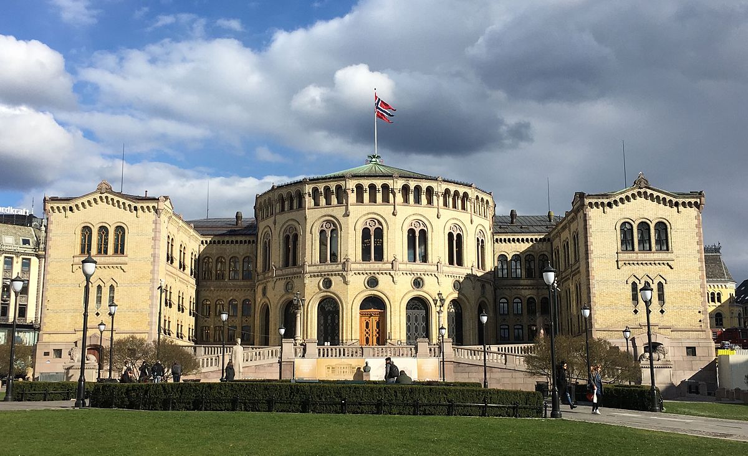
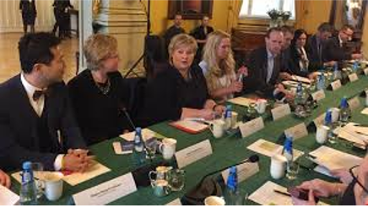
The road to the Norwegian Brain Health Strategy
2014 – Patient organizations startet lobbying togheter.
2015 - The organizations and The Norwegian Brain Council join forces.
2015 - The leading Parliament opposition party requested a plan for brain diseases.
2016 – The Health directorate was given the task to prepare a status report on brain health.
2017, February - The status report was published
2017, March – Summit with the Prime minister and Minster of Health.

Slide 3
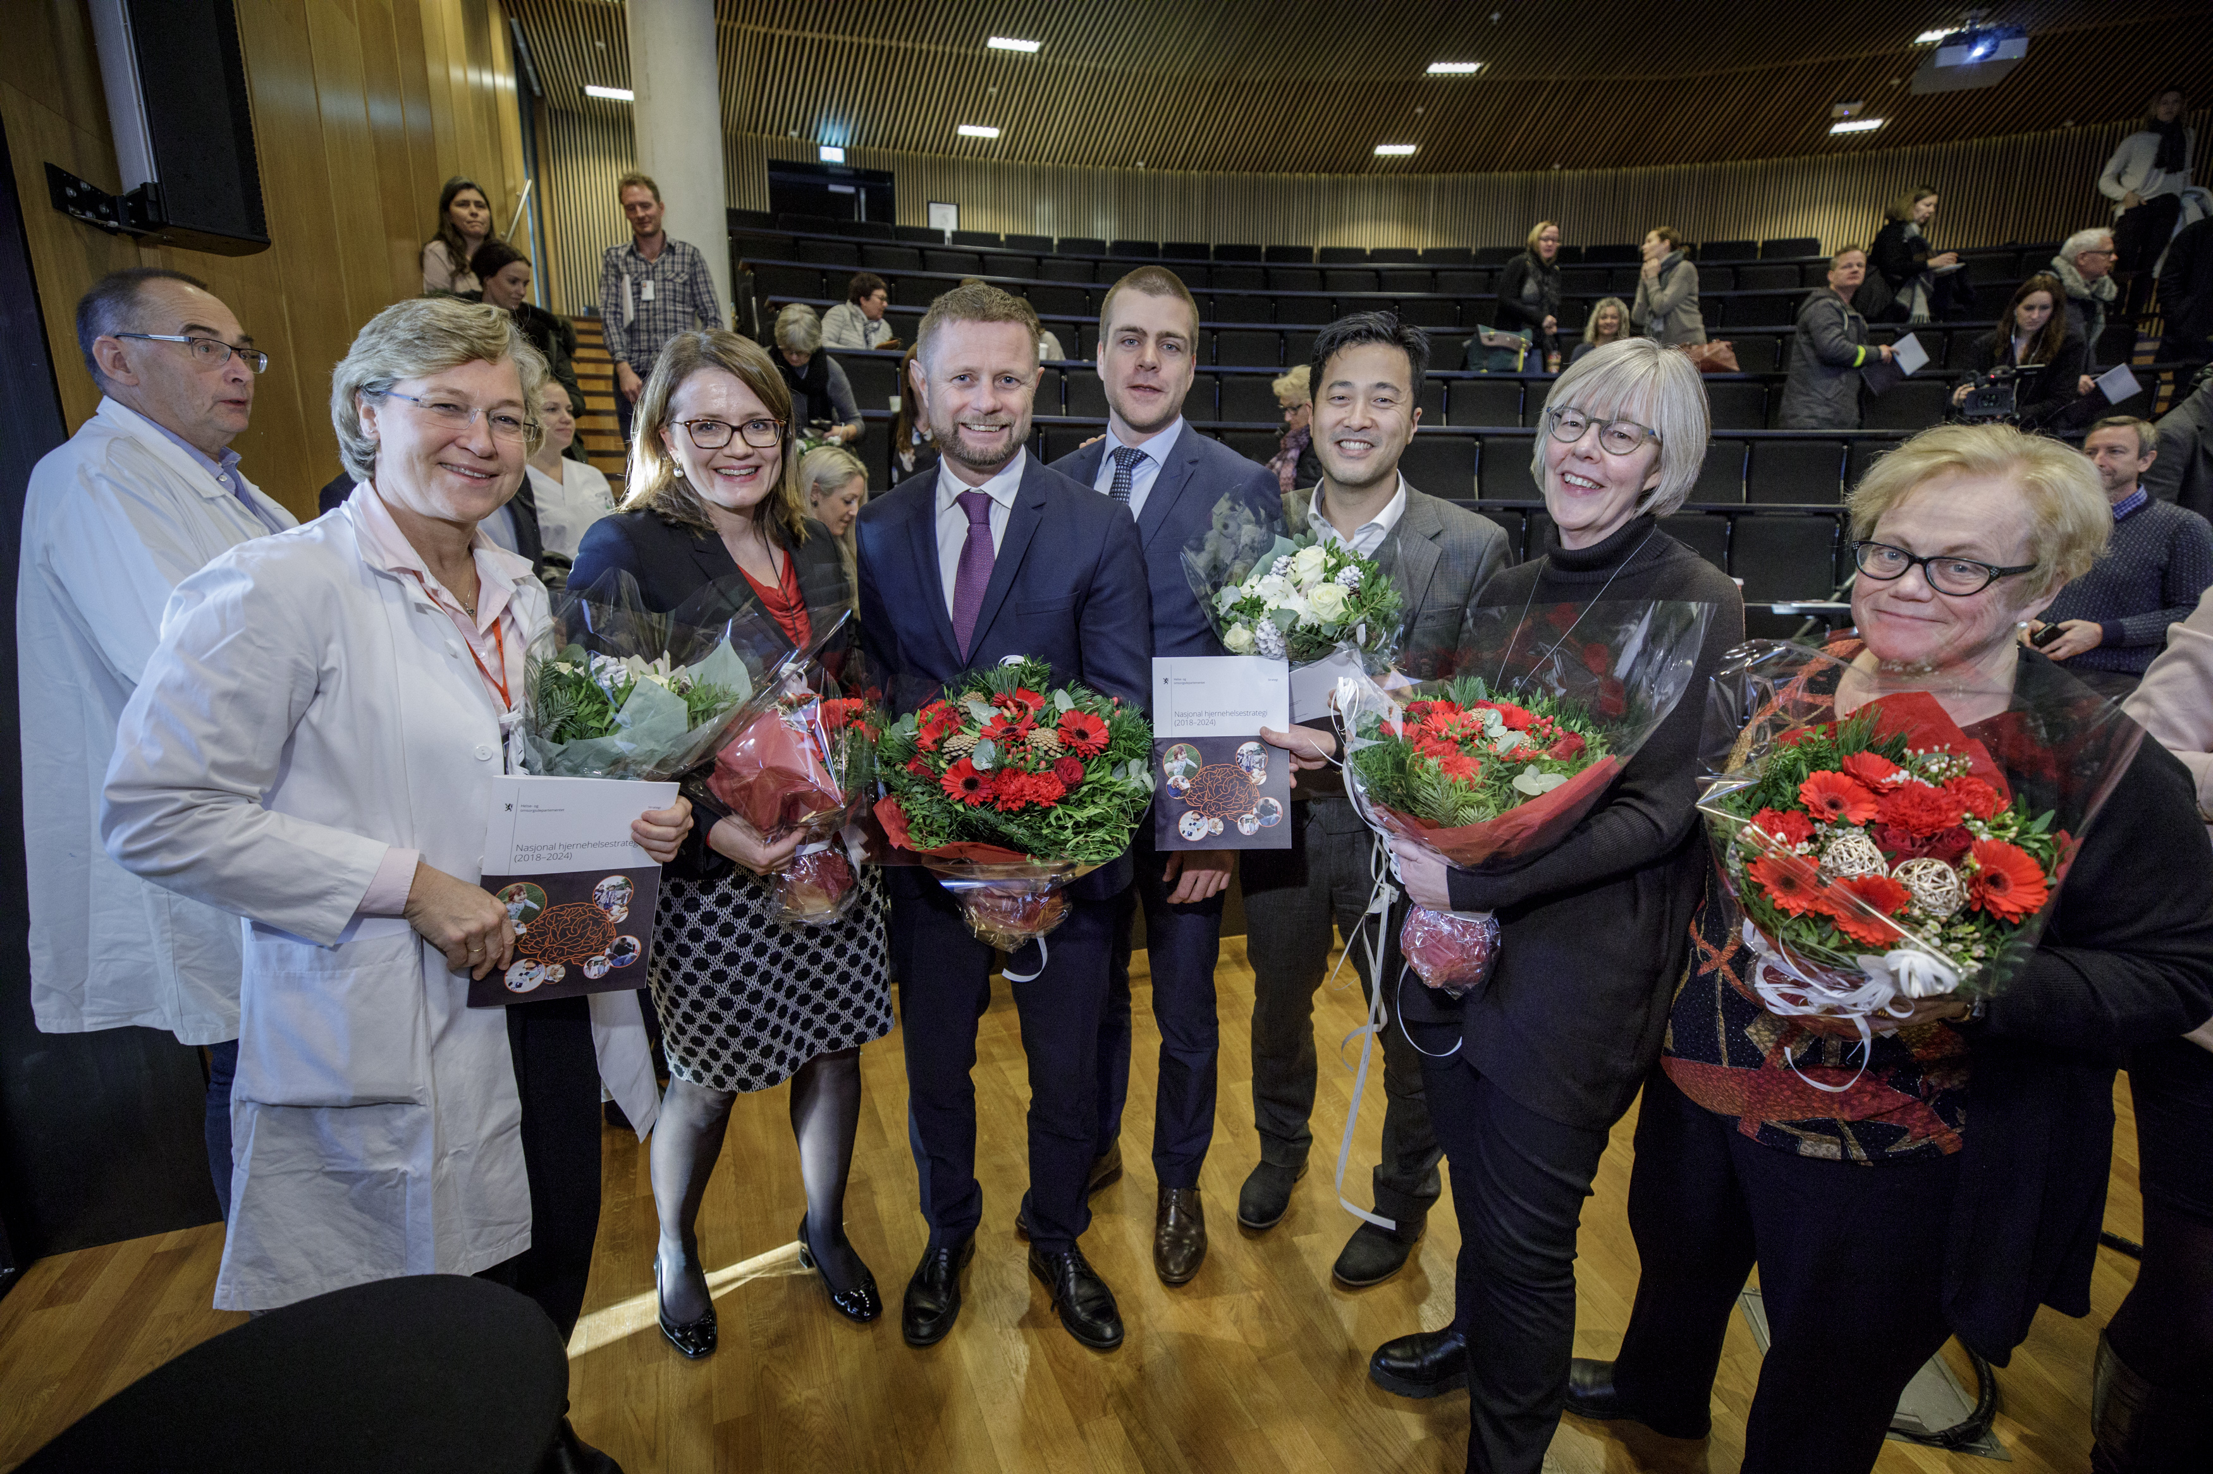
The launch of the Brain Health Strategy – December 2017

Slide 4
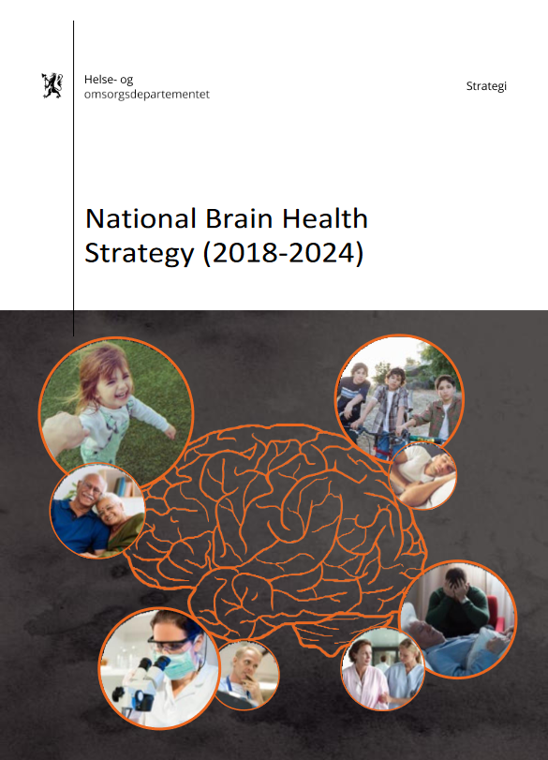
The Brain Health Strategy 2018-2024: Dec 12, 2017
Four main objectives:
Good life-long brain health, prevention and quality of life
Health care service tailored for the needs of the user and caretakers
Good health care from onset, diagnosis and treatment to habilitation and rehabilitation
Adequate knowledge and quality through research and innovation

Slide 5
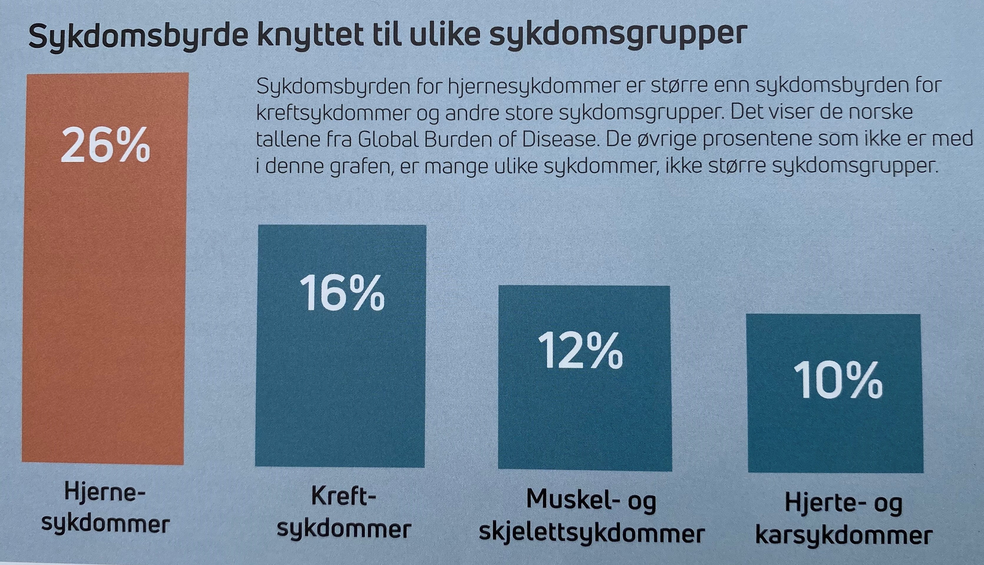
The Brain Health Strategy 2018-2024
Halfway through - The ongoing work
Challenge: Transform the objectives of the strategy into concrete measures.
Established partnership of stakeholders in the Directorate of Health.
Main outcomes:
  Health authorities has gained a better understanding for brain diseases as health category.
  More resources to research.
  Increasee in public awareness.
  An important base for
  governmental contact.

Slide 6
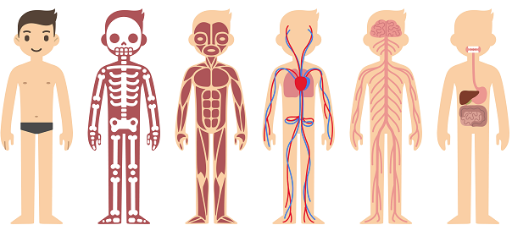
The Brain Health Strategy 2018-2024
What is next?
Research and information “easiest” goal to lobby.
Changes in treatment and rehabilitation - difficult to pinpoint solutions and not get diagnose specific.
We are trying to find superior measures that benefit broadly within brain diseases:
  Brain surveillance in intensive care units
  Ensure national competence centres within different brain diseases
  Establish brain diseases as a category in the national health statistics.
Started working politically for
our brain health strategy .2.0

